Slide 1
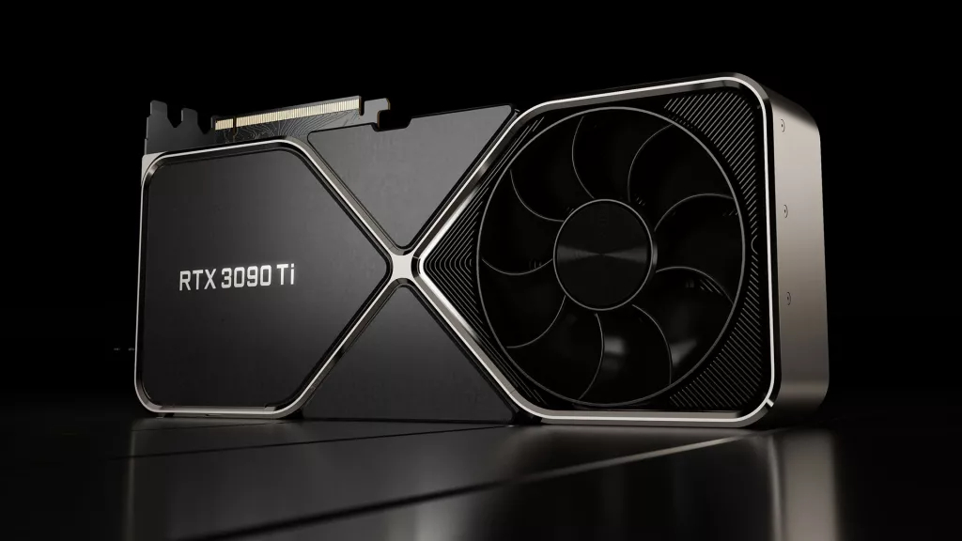


Pipelining
Notre Dame Cathedral
GMU CS695
Advanced Computer Architecture
Spring 2023
Lishan Yang

Slide 2
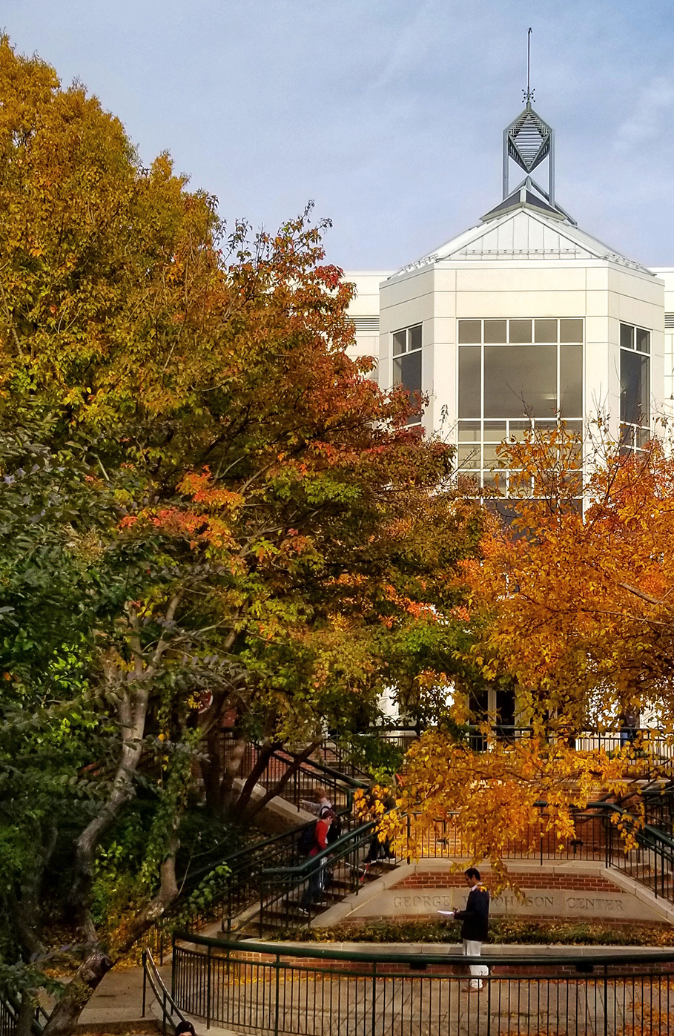
GMU CS695 Advanced Computer Architecture
Spring 2023
Lecture 3
Pipelining
Reference:
CMPE 140, Hyeran Jeon
CMPE 140, Donald Hung
CMPE 140, Haonan Wang
Computer Architecture: A Quantitative Approach
Licensed for use under a Creative Commons Attribution-NonCommercial-ShareAlike 3.0 Unported License.
Lishan Yang

Slide 3
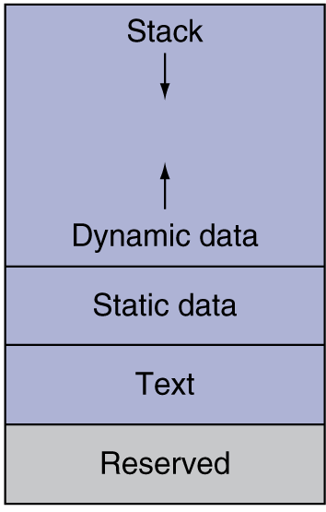


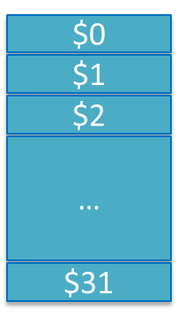
Instruction Processing
Return address
*fp
size
sum
CPU
numbers[1]
add*
numbers[0]
Instruction Processing
Compiled machine code
Decoder
Value of $4
A 32-bit instruction
The instruction is
- Opcode: add
- Rs: $4
- Rt: $3
- Rd: $5
Value of $3
Calculated result
To be stored to $5

Slide 4
Instruction Execution on CPU
To run a software, CPU
(IF) Fetches instructions from memory in the right order
(ID) Decodes the instruction and Reads the operand values from register file
(EXE) Executes the computation by using ALU
(MEM) Loads/store data from/to memory
(WB) Writes back the computation results to register file
Instruction Fetch
Decode & Register
Identify opcode & read operands
Execute
Mem
Write Result
Write to
dst register

Slide 5
Single-Cycle CPU Performance Analysis
The longest instruction’s execution time is 925 ps.
If we run 100 billion instructions, what is the total execution time?
The clock cycle period should be set to 925 ps
CPU time = # instructions x CPI x cycle period
= 100 x 10⁹ x 1 x 925 x 10⁻¹²
= 92.5 seconds

Slide 6
Performance Issues
Longest delay determines clock period
Critical path: load instruction
Instruction memory → register file → ALU → data memory → register file
Violates design principle
Making the common case fast
More arithmetic operations than memory operations
Most modern CPUs use multi-cycle processors
Each instruction takes multiple cycles
Multiple instructions can execute concurrently (parallelism → pipelining)

Slide 7





Pipelining Analogy
Laundry tasks
Place one dirty load of clothes in the washer
Place the wet load in the dryer
Place the dry load on a table and fold
Ask your roommate to put the clothes away

Slide 8
Pipelining Analogy
Laundry tasks
Place one dirty load of clothes in the washer
Place the wet load in the dryer
Place the dry load on a table and fold
Ask your roommate to put the clothes away

Slide 9
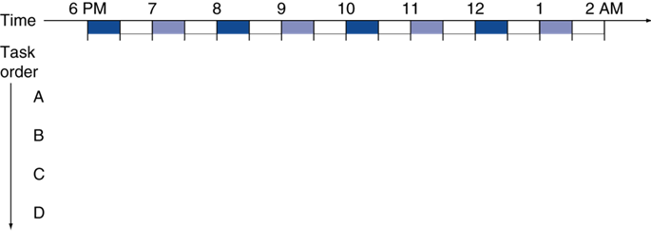

Pipelining Analogy
Lots of dirty clothes -- need to wash them over four separate loads
Assume each task takes 30 minutes
Inefficient!

Slide 10
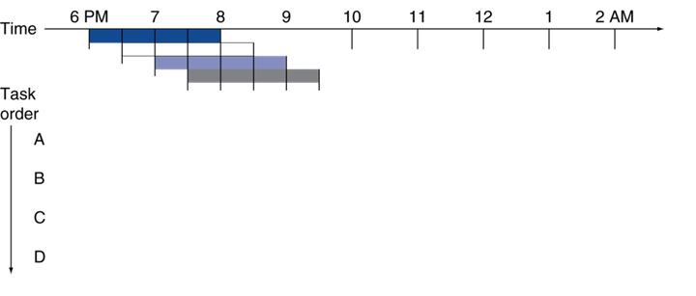




Pipelining Analogy
You can start the next load as soon as the washer finishes washing the previous load
Saved 4.5 hours

Slide 11
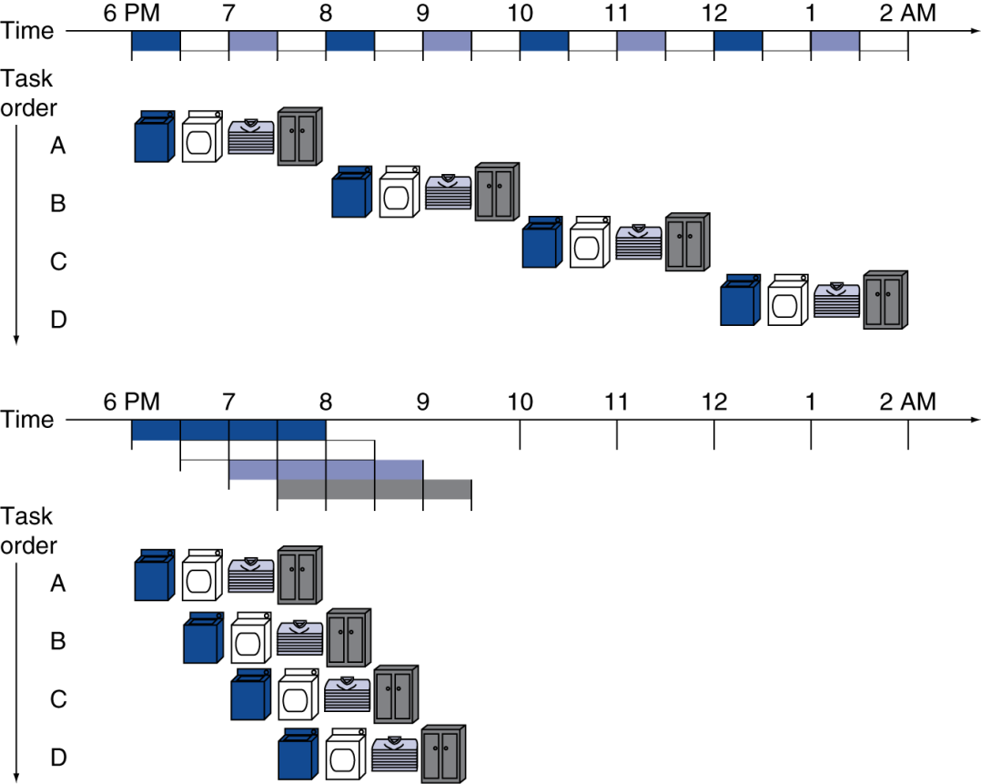
Pipelining Analogy
We can parallelize the single-cycle CPU tasks in a similar way
Pipelined laundry → overlapping execution
Single-cycle CPU
clock cycle period = 2hrs
Pipelined CPU
clock cycle period = 0.5hrs

Slide 12
5 steps in one cycle for single-cycle CPU design
With each step using separate resources
IF
ID
EXE
MEM
WB
Instruction Fetch
Decode & Register
Identify opcode & read operands
Execute
Mem
Write Result
Write to
dst register
CLK

Slide 13
MIPS Pipeline (Five-stage pipeline)
Entire datapath can be broken into five stages
Cycle period is changed to the time taken for a stage
Shorter clock cycle
Higher CPI (e.g., CPI = 5 in MIPS)
IF
ID
EXE
MEM
WB
Instruction Fetch
Decode & Register
Identify opcode & read operands
Execute
Mem
Write Result
Write to
dst register
CLK

Slide 14
MIPS Pipeline (Five-stage pipeline)
Entire datapath can be broken into five stages
Cycle period is changed to the time taken for a step
Shorter clock cycle
Higher CPI (e.g., CPI = 5 in MIPS)
System can achieve CPI = 1 by overlapping Multiple Instructions
 | CC1 | CC2 | CC3 | CC4 | CC5 | CC6 | CC7 | CC8 | CC9 | CC10 | CC11
Inst1 | IF | ID | EXE | MEM | WB
Inst2 |  | IF | ID | EXE | MEM | WB
Inst3 |  |  | IF | ID | EXE | MEM | WB
Inst4 |  |  |  | IF | ID | EXE | MEM | WB
Inst5 |  |  |  |  | IF | ID | EXE | MEM | WB
CC: clock cycle
After initial pipeline filling phase,
we can finish an instruction every cycle
Initial pipeline filling phase

Slide 15
Pipeline Performance Example
100ps for register IOs (i.e., decode, writeback); 200ps for other stages
What would be the cycle period in single-cycle and pipelined datapath?
What would be the execution time of lw instruction?
Instr | Instr fetch | Register read | ALU op | Memory access | Register write | Total time
lw | 200ps | 100 ps | 200ps | 200ps | 100 ps | 800ps
sw | 200ps | 100 ps | 200ps | 200ps |  | 700ps
R-type | 200ps | 100 ps | 200ps |  | 100 ps | 600ps
beq | 200ps | 100 ps | 200ps |  |  | 500ps

Slide 16
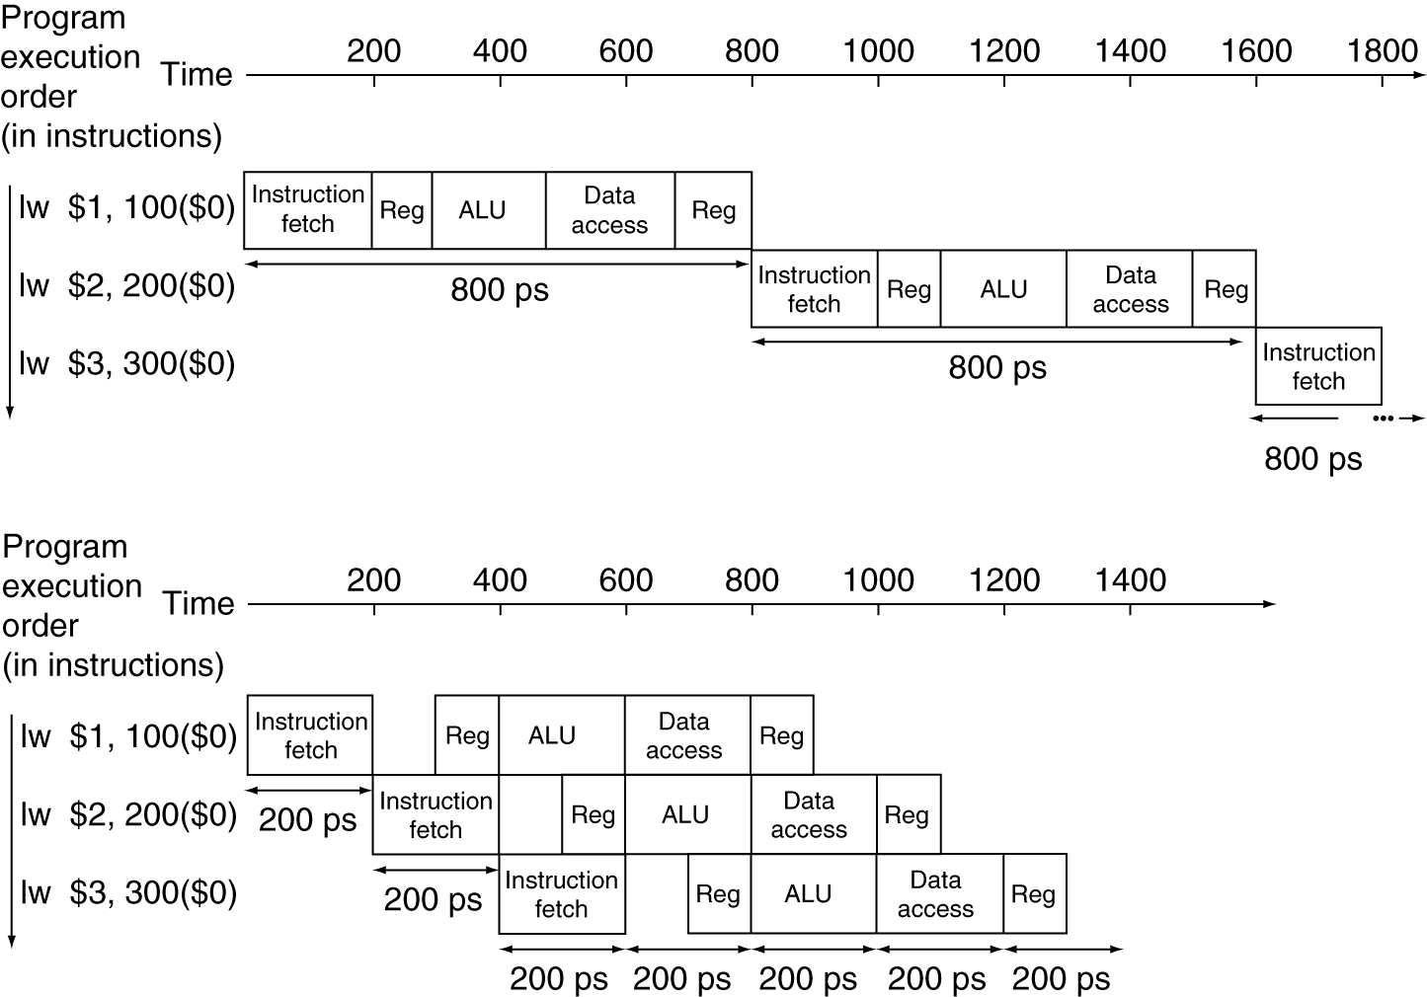
Pipeline Performance Example
Single-cycle (T_{c}= 800ps)
T_{c} = Longest instruction
T_{lw} = 800ps
2 x T_{lw} = 1600ps
…
Pipelined (T_{c}= 200ps)
T_{c} = Longest Stage
T_{lw} = 1000ps
2 x T_{lw} = 1200ps
…

Slide 17
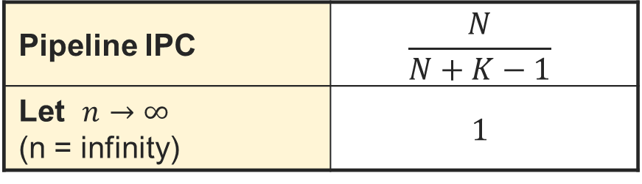
Throughput
CPI: Cycle per instruction
- The smaller the better
IPC: Instruction per cycle
- The larger the better
Throughput (T) = # of instructions executed / time
IPC = Instruction Per Cycle = 1 / CPI
For a large number of instructions, the IPC of a pipelined processor is 1 instruction per clock cycle
Only when we keep the pipeline full of instructions
Assume we execute N instructions using a K stage datapath
Pipeline IPC | $$\frac{N}{N+K−1}$$
Let $n→∞$ (n = infinity) | $$1$$

Slide 18
Hazards
Any sequence of instructions that prevent full pipeline utilization
Often causes the pipeline to stall for one or more instructions
Structural Hazards
HW organization cannot support certain combinations of instructions being overlapped
Data Hazards
Data dependencies
Control Hazards
Branches & changes to PC in the pipeline
If branch is determined to be taken later in the pipeline, flush (delete) the instructions in the pipeline that shouldn’t be executed
Hardware (not homework!)

Slide 19
Structural Hazards
Combinations of instructions that cannot be overlapped in the given order due to HW constraints
Often due to lack of HW resources
Example: A single memory rather than separate I & D Memories
Structural hazard whenever an instruction needs to perform a data access (i.e. ‘lw’ or ‘sw’)
PC
i+1
i
LW
Reg.
File
ALU
i+2
Hazard!
IF: fetch the instruction, write to memory
…
MEM: write the data to memory
Memory
This is not a good design :(
Fix:
Instruction cache (ICache)
Data cache (DCache)

Slide 20
Data Hazards
Read-After-Write (RAW)
A following instruction reads a result from a previous instruction
Write-After-Read (WAR)
Write-After-Write (WAW)
RAW Example
LW $t1,4($s0)
ADD $t5,$t1,$t4
Initial Conditions:
$s0 = 0x10010000
$t1 = 0x0
00000060
0x10010004
$t4 = 0x24
12345678
0x10010000
$t5 = 0x0
After execution values should be:
$s0 = 0x10010000
$t1 = 0x60
$t4 = 0x24
$t5 = 0x84

Slide 21
Cause of Data Hazards
Stalling the pipeline to prevent error:
All instructions in front of the stalled instruction can continue
All instructions behind the stalled instruction must also stall
Stalling inserts “bubbles” / nops (no-operations) into the pipeline
A “nop” is an actual instruction in the MIPS ISA that does NOTHING

Slide 22
Data Hazards Example
Using stalls to handle dependencies
RAW Example
LW $t1,4($s0)
ADD $t5,$t1,$t4
 | CC1 | CC2 | CC3 | CC4 | CC5 | CC6 | CC7 | CC8 | CC9 | CC10 | CC11
LW | IF
ADD
Next instr.
Next+1
Next+2
Next+3
Next+4

Slide 23
Data Hazards Example
Using stalls to handle dependencies
RAW Example
LW $t1,4($s0)
ADD $t5,$t1,$t4
 | CC1 | CC2 | CC3 | CC4 | CC5 | CC6 | CC7 | CC8 | CC9 | CC10 | CC11
LW | IF | ID
ADD |  | IF
Next instr.
Next+1
Next+2
Next+3
Next+4

Slide 24
Data Hazards Example
Using stalls to handle dependencies
RAW Example
LW $t1,4($s0)
ADD $t5,$t1,$t4
 | CC1 | CC2 | CC3 | CC4 | CC5 | CC6 | CC7 | CC8 | CC9 | CC10 | CC11
LW | IF | ID | EXE
ADD |  | IF | ID
Next instr. |  |  | IF
Next+1
Next+2
Next+3
Next+4

Slide 25
Data Hazards Example
Using stalls to handle dependencies
Dependency detected (ADD cannot do EXE because $t1 is not ready)
RAW Example
LW $t1,4($s0)
ADD $t5,$t1,$t4
 | CC1 | CC2 | CC3 | CC4 | CC5 | CC6 | CC7 | CC8 | CC9 | CC10 | CC11
LW | IF | ID | EXE
ADD |  | IF | ID
Next instr. |  |  | IF
Next+1
Next+2
Next+3
Next+4
Hazard

Slide 26
Data Hazards Example
Using stalls to handle dependencies
RAW Example
LW $t1,4($s0)
ADD $t5,$t1,$t4
Stays in ID stage
 | CC1 | CC2 | CC3 | CC4 | CC5 | CC6 | CC7 | CC8 | CC9 | CC10 | CC11
LW | IF | ID | EXE | MEM
ADD |  | IF | ID
Next instr. |  |  | IF
Next+1
Next+2
Next+3
Next+4
nop
nop

Slide 27
Data Hazards Example
Using stalls to handle dependencies
RAW Example
LW $t1,4($s0)
ADD $t5,$t1,$t4
 | CC1 | CC2 | CC3 | CC4 | CC5 | CC6 | CC7 | CC8 | CC9 | CC10 | CC11
LW | IF | ID | EXE | MEM | WB
ADD |  | IF | ID
Next instr. |  |  | IF
Next+1
Next+2
Next+3
Next+4
Read new value again
nop
nop
nop
nop

Slide 28
Data Hazards Example
Using stalls to handle dependencies
RAW Example
LW $t1,4($s0)
ADD $t5,$t1,$t4
 | CC1 | CC2 | CC3 | CC4 | CC5 | CC6 | CC7 | CC8 | CC9 | CC10 | CC11
LW | IF | ID | EXE | MEM | WB
ADD |  | IF | ID |  |  | EXE
Next instr. |  |  | IF |  |  | ID
Next+1 |  |  |  |  |  | IF
Next+2
Next+3
Next+4
nop
nop
nop
nop

Slide 29
Data Hazards Example
Using stalls to handle dependencies
RAW Example
LW $t1,4($s0)
ADD $t5,$t1,$t4
 | CC1 | CC2 | CC3 | CC4 | CC5 | CC6 | CC7 | CC8 | CC9 | CC10 | CC11 | CC12 | CC13
LW | IF | ID | EXE | MEM | WB
ADD |  | IF | ID |  |  | EXE | MEM | WB
Next instr. |  |  | IF |  |  | ID | EXE | MEM | WB
Next+1 |  |  |  |  |  | IF | ID | EXE | MEM | WB
Next+2 |  |  |  |  |  |  | IF | ID | EXE | MEM | WB
Next+3 |  |  |  |  |  |  |  | IF | ID | EXE | MEM | WB
Next+4 |  |  |  |  |  |  |  |  | IF | ID | EXE | MEM | WB
nop
nop
nop
nop
Throughput = 7 insts/13 cycles = 0.53
vs.
Throughput without hazard = 7 insts/11 cycles = 0.63

Slide 30
Pipeline Stall for Data Hazards
ADD can read the updated register value from the register file in the same cycle as LW writes the loaded data to register
Do we really need to wait until LW updates the register file?
Why don’t we use this data directly?
 | CC1 | CC2 | CC3 | CC4 | CC5 | CC6 | CC7 | CC8 | CC9 | CC10 | CC11 | CC12 | CC13
LW | IF | ID | EXE | MEM | WB
ADD |  | IF | ID |  |  | EXE | MEM | WB
Next instr. |  |  | IF |  |  | ID | EXE | MEM | WB
Next+1 |  |  |  |  |  | IF | ID | EXE | MEM | WB
Next+2 |  |  |  |  |  |  | IF | ID | EXE | MEM | WB
Next+3 |  |  |  |  |  |  |  | IF | ID | EXE | MEM | WB
Next+4 |  |  |  |  |  |  |  |  | IF | ID | EXE | MEM | WB
nop
nop
nop
nop

Slide 31
Data Hazards Solutions
Compiler
Reorder Code
Hardware
Use forwarding / bypassing
Data forwarding
Take results still in the pipeline (not yet written back to a register) and pass them to dependent instructions
Forwarding Path
Load instruction: from WB to EXE
R-type instructions: from MEM to EXE

Slide 32
Data Forwarding
Only one stall to wait for LW reads data from memory
Saved 1 cycles
compared to w/o forwarding
 | CC1 | CC2 | CC3 | CC4 | CC5 | CC6 | CC7 | CC8 | CC9 | CC10 | CC11 | CC12 | CC13
LW | IF | ID | EXE | MEM | WB
ADD |  | IF | ID | ID | EXE | MEM | WB
Next instr. |  |  | IF | IF | ID | EXE | MEM | WB
Next+1 |  |  |  |  | IF | ID | EXE | MEM | WB
Next+2 |  |  |  |  |  | IF | ID | EXE | MEM | WB
Next+3 |  |  |  |  |  |  | IF | ID | EXE | MEM | WB
Next+4 |  |  |  |  |  |  |  | IF | ID | EXE | MEM | WB
nop
nop

Slide 33
Data Forwarding
As far as earlier instruction’s result is in pipeline, the result value can be forwarded to the following instructions
In arithmetic operations, no stall is needed
 | CC1 | CC2 | CC3 | CC4 | CC5 | CC6 | CC7 | CC8 | CC9 | CC10
ADD | IF | ID | EXE | MEM | WB
SUB |  | IF | ID | EXE | MEM | WB
XOR |  |  | IF | ID | EXE | MEM | WB
Next+1 |  |  |  | IF | ID | EXE | MEM | WB
Next+2 |  |  |  |  | IF | ID | EXE | MEM | WB
Next+3 |  |  |  |  |  | IF | ID | EXE | MEM | WB
ADD $t3,$t1,$t2
SUB $t5,$t3,$t4
XOR $t7,$t5,$t3

Slide 34
Pipeline Latency with Forwarding/Stall
Number of cycles we must stall to execute a dependent instruction:
Instruction that is the dependency source | w/o Forwarding (cycles) | w/ Forwarding (cycles)
LW | 2 | 1
Other instructions that update register file | 2 | 0
Data Hazards Solutions:
- Hardware: stalling & forwarding
- Software: compiler -- code reordering/rescheduling

Slide 35
Code Scheduling to Avoid Stalls
Compiler can reorder code to avoid the stalls
C code A = B + E; C = B + F;
lw $t1, 0($t0)
lw $t2, 4($t0)
add $t3, $t1, $t2
sw $t3, 12($t0)
lw $t4, 8($t0)
add $t5, $t1, $t4
sw $t5, 16($t0)
Find RAW dependencies and check if stall is needed

Slide 36
Code Scheduling to Avoid Stalls
Compiler can reorder code to avoid the stalls
C code A = B + E; C = B + F;
lw $t1, 0($t0)
lw $t2, 4($t0)
add $t3, $t1, $t2
sw $t3, 12($t0)
lw $t4, 8($t0)
add $t5, $t1, $t4
sw $t5, 16($t0)
Find RAW dependencies and check if stall is needed
When forwarding is used,
only lw instruction causes stall
Leave lw instructions only

Slide 37
Code Scheduling to Avoid Stalls
Compiler can reorder code to avoid the stalls
C code A = B + E; C = B + F;
lw $t1, 0($t0)
lw $t2, 4($t0)
add $t3, $t1, $t2
sw $t3, 12($t0)
lw $t4, 8($t0)
add $t5, $t1, $t4
sw $t5, 16($t0)
Find RAW dependencies and check if stall is needed
lw instructions cause 1-cycle stalls
Leave instructions that are executed back-to-back only

Slide 38
Code Scheduling to Avoid Stalls
Compiler can reorder code to avoid the stalls
C code A = B + E; C = B + F;
lw $t1, 0($t0)
lw $t2, 4($t0)
add $t3, $t1, $t2
sw $t3, 12($t0)
lw $t4, 8($t0)
add $t5, $t1, $t4
sw $t5, 16($t0)
Now, check if the lw and dependent instructions must be executed back-to-back

Slide 39
Code Scheduling to Avoid Stalls
Compiler can reorder code to avoid the stalls
C code A = B + E; C = B + F;
lw $t1, 0($t0)
lw $t2, 4($t0)
add $t3, $t1, $t2
sw $t3, 12($t0)
lw $t4, 8($t0)
add $t5, $t1, $t4
sw $t5, 16($t0)
lw $t1, 0($t0)
lw $t2, 4($t0)
lw $t4, 8($t0)
add $t3, $t1, $t2
sw $t3, 12($t0)
add $t5, $t1, $t4
sw $t5, 16($t0)

Slide 40
Code Scheduling to Avoid Stalls
Compiler can reorder code to avoid the stalls
C code A = B + E; C = B + F;
lw $t1, 0($t0)
lw $t2, 4($t0)
add $t3, $t1, $t2
sw $t3, 12($t0)
lw $t4, 8($t0)
add $t5, $t1, $t4
sw $t5, 16($t0)
lw $t1, 0($t0)
lw $t2, 4($t0)
lw $t4, 8($t0)
add $t3, $t1, $t2
sw $t3, 12($t0)
add $t5, $t1, $t4
sw $t5, 16($t0)
stall
stall
Total
execution time
5 cycles for the first inst +
6 cycles for the remaining insts +
2 x 1 stall cycles = 13 cycles
5 cycles for the first inst +
6 cycles for the remaining insts +
0 stall cycles = 11 cycles

Slide 41
Control Hazard
Branch outcomes: Taken (T) or Not-Taken (NT)
Not known until late in the pipeline
Prevents us from fetching future instructions
Solution: rather than stall, we can predict the outcome and keep fetching
We only need to correct the pipeline if we guess wrong
Static Predictions
Predict Taken
Predict Not Taken
T
--- beq L1 L2 --- --- --- --- beq L2 L1 ---
NT
T
NT

Slide 42
Statically Predict Not Taken
Keep fetching instructions from the PC + 4 by assuming that the branch will be not taken
Once branch is turned out to be taken, flush the incorrectly fetched instructions
In the following cycle, fetch the instruction from the branch target address

Slide 43
Static Branch Prediction Penalty
Penalty = number of instructions that need to be flushed on misprediction
For static branch prediction:
The branch outcome and target address is available at the MEM stage and passed back to the Fetch stage
If mispredicted, instructions of the correct path will be fetched on the next cycle
A 3-cycle branch penalty when mispredicted

Slide 44
Statically Predict Not Taken
 | CC1 | CC2 | CC3 | CC4 | CC5 | CC6 | CC7 | CC8 | CC9 | CC10
BEQ | IF | ID | EXE | MEM
ADD |  | IF | ID | EXE
SUB |  |  | IF | ID
OR |  |  |  | IF
NT!
Actual Branch Outcome
BEQ $a0,$a1,L1 (NT)
L2: ADD $s1,$t1,$t2
SUB $t3,$t0,$s0
OR $s0,$t6,$t7
BNE $a0,$s1,L2 (T)
L1: AND $t3,$t6,$t7
SW $t5,0($s1)
LW $s2,0($s5)

Slide 45
Statically Predict Not Taken
 | CC1 | CC2 | CC3 | CC4 | CC5 | CC6 | CC7 | CC8 | CC9 | CC10
BEQ | IF | ID | EXE | MEM | WB
ADD |  | IF | ID | EXE | MEM
SUB |  |  | IF | ID | EXE
OR |  |  |  | IF | ID
BNE |  |  |  |  | IF
Actual Branch Outcome
BEQ $a0,$a1,L1 (NT)
L2: ADD $s1,$t1,$t2
SUB $t3,$t0,$s0
OR $s0,$t6,$t7
BNE $a0,$s1,L2 (T)
L1: AND $t3,$t6,$t7
SW $t5,0($s1)
LW $s2,0($s5)

Slide 46
Statically Predict Not Taken
 | CC1 | CC2 | CC3 | CC4 | CC5 | CC6 | CC7 | CC8 | CC9 | CC10
BEQ | IF | ID | EXE | MEM | WB
ADD |  | IF | ID | EXE | MEM | WB
SUB |  |  | IF | ID | EXE | MEM
OR |  |  |  | IF | ID | EXE
BNE |  |  |  |  | IF | ID
AND |  |  |  |  |  | IF
Actual Branch Outcome
BEQ $a0,$a1,L1 (NT)
L2: ADD $s1,$t1,$t2
SUB $t3,$t0,$s0
OR $s0,$t6,$t7
BNE $a0,$s1,L2 (T)
L1: AND $t3,$t6,$t7
SW $t5,0($s1)
LW $s2,0($s5)

Slide 47
Statically Predict Not Taken
 | CC1 | CC2 | CC3 | CC4 | CC5 | CC6 | CC7 | CC8 | CC9 | CC10
BEQ | IF | ID | EXE | MEM | WB
ADD |  | IF | ID | EXE | MEM | WB
SUB |  |  | IF | ID | EXE | MEM | WB
OR |  |  |  | IF | ID | EXE | MEM | WB
BNE |  |  |  |  | IF | ID | EXE | MEM
AND |  |  |  |  |  | IF | ID | EXE
SW |  |  |  |  |  |  | IF | ID
LW |  |  |  |  |  |  |  | IF
Actual Branch Outcome
BEQ $a0,$a1,L1 (NT)
L2: ADD $s1,$t1,$t2
SUB $t3,$t0,$s0
OR $s0,$t6,$t7
BNE $a0,$s1,L2 (T)
L1: AND $t3,$t6,$t7
SW $t5,0($s1)
LW $s2,0($s5)
T!
Flush

Slide 48
Statically Predict Not Taken
 | CC1 | CC2 | CC3 | CC4 | CC5 | CC6 | CC7 | CC8 | CC9 | CC10
BEQ | IF | ID | EXE | MEM | WB
ADD |  | IF | ID | EXE | MEM | WB
SUB |  |  | IF | ID | EXE | MEM | WB
OR |  |  |  | IF | ID | EXE | MEM | WB
BNE |  |  |  |  | IF | ID | EXE | MEM | WB
AND |  |  |  |  |  | IF | ID | EXE
SW |  |  |  |  |  |  | IF | ID
LW |  |  |  |  |  |  |  | IF
ADD |  |  |  |  |  |  |  |  | IF | ID
SUB |  |  |  |  |  |  |  |  |  | IF
Actual Branch Outcome
BEQ $a0,$a1,L1 (NT)
L2: ADD $s1,$t1,$t2
SUB $t3,$t0,$s0
OR $s0,$t6,$t7
BNE $a0,$s1,L2 (T)
L1: AND $t3,$t6,$t7
SW $t5,0($s1)
LW $s2,0($s5)
nop
nop
nop
nop
nop
nop
Instruction in the
target address (L2)

Slide 49
Predict Taken?
It is not possible to statically predict all the branches to be taken
The branch target address is not computed until the EX stage, so we don’t have the PC values even needed to predict taken
Dynamic branch prediction + branch target buffer enables to predict taken
Predict untaken a few times to collect branch target address of each branch and then predict taken based on the history
Can we reduce branch penalty with change of datapath?

Slide 50
Early Determination w/ Predict NT
 | CC1 | CC2 | CC3 | CC4 | CC5 | CC6 | CC7 | CC8 | CC9 | CC10
BEQ | IF | ID | EXE | MEM | WB
ADD |  | IF | ID | EXE | MEM | WB
SUB |  |  | IF | ID | EXE | MEM
OR |  |  |  | IF | ID | EXE
BNE |  |  |  |  | IF | ID
AND |  |  |  |  |  | IF
Actual Branch Outcome
BEQ $a0,$a1,L1 (NT)
L2: ADD $s1,$t1,$t2
SUB $t3,$t0,$s0
OR $s0,$t6,$t7
BNE $a0,$s1,L2 (T)
L1: AND $t3,$t6,$t7
SW $t5,0($s1)
LW $s2,0($s5)
T!
Flush

Slide 51
Early Determination w/ Predict NT
 | CC1 | CC2 | CC3 | CC4 | CC5 | CC6 | CC7 | CC8 | CC9 | CC10
BEQ | IF | ID | EXE | MEM | WB
ADD |  | IF | ID | EXE | MEM | WB
SUB |  |  | IF | ID | EXE | MEM | WB
OR |  |  |  | IF | ID | EXE | MEM | WB
BNE |  |  |  |  | IF | ID | EXE | MEM | WB
AND |  |  |  |  |  | IF
ADD |  |  |  |  |  |  | IF | ID | EXE | MEM
SUB |  |  |  |  |  |  |  | IF | ID | EXE
Actual Branch Outcome
BEQ $a0,$a1,L1 (NT)
L2: ADD $s1,$t1,$t2
SUB $t3,$t0,$s0
OR $s0,$t6,$t7
BNE $a0,$s1,L2 (T)
L1: AND $t3,$t6,$t7
SW $t5,0($s1)
LW $s2,0($s5)
T!
Flush
nop
nop
nop
nop
Instruction in the
target address (L2)

Slide 52
Early Determination w/ Predict NT
 | CC1 | CC2 | CC3 | CC4 | CC5 | CC6 | CC7 | CC8 | CC9 | CC10
BEQ | IF | ID | EXE | MEM | WB
ADD |  | IF | ID | EXE | MEM | WB
SUB |  |  | IF | ID | EXE | MEM
OR |  |  |  | IF | ID | EXE
BNE |  |  |  |  | IF | ID
AND |  |  |  |  |  | IF
Actual Branch Outcome
BEQ $a0,$a1,L1 (NT)
L2: ADD $s1,$t1,$t2
SUB $t3,$t0,$s0
OR $s0,$t6,$t7
BNE $s0,$s1,L2 (T)
L1: AND $t3,$t6,$t7
SW $t5,0($s1)
LW $s2,0($s5)

Slide 53
Early Determination w/ Predict NT
 | CC1 | CC2 | CC3 | CC4 | CC5 | CC6 | CC7 | CC8 | CC9 | CC10
BEQ | IF | ID | EXE | MEM | WB
ADD |  | IF | ID | EXE | MEM | WB
SUB |  |  | IF | ID | EXE | MEM | WB
OR |  |  |  | IF | ID | EXE | MEM
BNE |  |  |  |  | IF | ID | ID
AND |  |  |  |  |  | IF | IF
Actual Branch Outcome
BEQ $a0,$a1,L1 (NT)
L2: ADD $s1,$t1,$t2
SUB $t3,$t0,$s0
OR $s0,$t6,$t7
BNE $s0,$s1,L2 (T)
L1: AND $t3,$t6,$t7
SW $t5,0($s1)
LW $s2,0($s5)
T!

Slide 54
Early Determination w/ Predict NT
If BNE has dependency with its preceding instruction, OR, one cycle stall is required to get the OR’s result value
→ Still better than normal 3 cycle flushing
 | CC1 | CC2 | CC3 | CC4 | CC5 | CC6 | CC7 | CC8 | CC9 | CC10
BEQ | IF | ID | EXE | MEM | WB
ADD |  | IF | ID | EXE | MEM | WB
SUB |  |  | IF | ID | EXE | MEM | WB
OR |  |  |  | IF | ID | EXE | MEM | WB
BNE |  |  |  |  | IF | ID | ID | EXE | MEM | WB
AND |  |  |  |  |  | IF | IF
ADD |  |  |  |  |  |  |  | IF | ID | EXE
SUB |  |  |  |  |  |  |  |  | IF | ID
Actual Branch Outcome
BEQ $a0,$a1,L1 (NT)
L2: ADD $s1,$t1,$t2
SUB $t3,$t0,$s0
OR $s0,$t6,$t7
BNE $s0,$s1,L2 (T)
L1: AND $t3,$t6,$t7
SW $t5,0($s1)
LW $s2,0($s5)
What about a LW here?
T!
nop
nop
nop
What about NT here?
Instruction in the
target address (L2)

Slide 55
Branch Delay Slot
 | CC1 | CC2 | CC3 | CC4 | CC5 | CC6 | CC7 | CC8 | CC9 | CC10
BEQ | IF | ID | EXE | MEM | WB
ADD |  | IF | ID | EXE | MEM | WB
SUB |  |  | IF | ID | EXE | MEM | WB
OR |  |  |  | IF | ID | EXE | MEM | WB
BNE |  |  |  |  | IF | ID | EXE | MEM | WB
AND |  |  |  |  |  | IF
ADD |  |  |  |  |  |  | IF | ID | EXE | MEM
SUB |  |  |  |  |  |  |  | IF | ID | EXE
Actual Branch Outcome
Find an instruction that
1) has to be executed regardless branch outcome
2) independent to branch
BEQ $a0,$a1,L1 (NT)
L2: ADD $s1,$t1,$t2
SUB $t3,$t0,$s0
OR $s0,$t6,$t7
BNE $a0,$s1,L2 (T)
L1: AND $t3,$t6,$t7
SW $t5,0($s1)
LW $s2,0($s5)
T!
Flush
The instruction will be placed in the branch delay slot (right after branch instruction) instead of fetching wrong instruction and flushing
nop
nop
nop
nop
Instruction in the
target address (L2)

Slide 56
Branch Delay Slot
 | CC1 | CC2 | CC3 | CC4 | CC5 | CC6 | CC7 | CC8 | CC9 | CC10
BEQ | IF | ID | EXE | MEM | WB
ADD |  | IF | ID | EXE | MEM | WB
SUB |  |  | IF | ID | EXE | MEM | WB
BNE |  |  |  | IF | ID | EXE | MEM | WB
OR |  |  |  |  | IF | ID | EXE | MEM | WB
ADD |  |  |  |  |  | IF | ID | EXE | MEM | WB
SUB |  |  |  |  |  |  | IF | ID | EXE | MEM
Actual Branch Outcome
No Flush
& Better Performance
BEQ $a0,$a1,L1 (NT)
L2: ADD $s1,$t1,$t2
SUB $t3,$t0,$s0
BNE $a0,$s1,L2 (T)
OR $s0,$t6,$t7
L1: AND $t3,$t6,$t7
SW $t5,0($s1)
LW $s2,0($s5)
Instruction in the
target address (L2)

Slide 57
Branch Delay Slot
Require implementation on both the CPU and the compiler
If no suitable instruction can be found for the slot, then a NOP will be filled
Branch delay slot is more useful for unconditional branches such as j, jal, jr because they are always taken
For example, if jal uses branch delay slot,
After jal, $ra is updated with PC + 8
The instruction in PC + 4 is executed after jal before entering the subfunction

Slide 58
Dynamic Branch Prediction
Monitor the branch patterns for better prediction
i.e. loops usually have a few iterations, so the branch in the loop is likely to be not taken at least for a few times
Branch Prediction Buffer (branch history buffer) is used to maintain each branch’s outcome history
Small storage space indexed with certain bits of branch instruction’s PC value
Each entry maintains the previous outcome of each branch
Once the branch outcome is available, the corresponding entry is updated

Slide 59
Branch Prediction Buffer
Aliasing issue
Different branch instructions may map to the same branch prediction buffer entry if their PC values have the same LSBs, affecting each others’ predictions
E.g., 0x8004 and 0x8104 will access the same entry if [3:2] bits are used for indexing
Inevitable but can be alleviated with larger buffer
Branch Prediction Buffer
Branch instruction’s PC value (i.e. 0x8004)
 | prediction bit
0 | 1
1 | 0
2 | 1
3 | 1
1: Predict Taken
0: Predict Not Taken
1000 0000 0000 0100
[3:2] bits
The bits to be included to the prediction
may be different depending on the prediction buffer size
Prediction bit field can have multiple bits to record more history
→ PC can be recorded to predict Taken

Slide 60


1-bit Predictor
Each entry of branch prediction buffer is 1-bit (1: Taken, 0: Not Taken)
The entry value is the latest outcome of the branch
Next outcome of the branch is predicted based on current value
Example: Assume that the actual outcomes of the branches at 0xDC04, 0xDC08, and 0xDC20 are untaken, taken, and untaken, respectively
0xDC04 for(i=0;i<10000;i++)
{
0xDC08 if( ( i % 100) == 0 )
tick( );
0xDC20 if( (i % 2) == 0)
even();
}
prediction bit
0
1
0
..
predicted NT
Actual result: NT
0
predicted T
Actual result: NT
1
predicted NT
Actual result: T

Slide 61
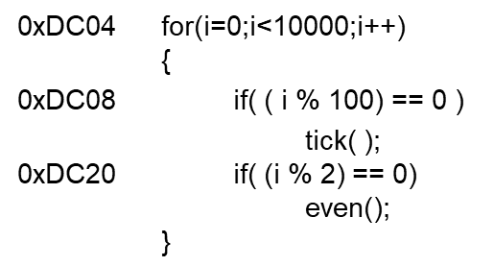
Is 1 bit Enough?
Taken to exit the loop
Not taken and continue to the loop body
NT
TN
DC04: NNNNNNN ... NNNNNNNNNNT
NNNNNNNNN …
10,000 iterations
10,000 iterations …
Mis-predictions for every
first and last iterations
→ 99.998% Correct Prediction
Mis-predictions: 2 / 10,000
DC08: TTTTT ... TNTTTTT … TNTTTTT …
98.0% Correct Prediction
Mis-predictions: 2 / 100
DC20: TNTNTNTNTNTNTNTNTNTNTNTNTNTNT …
0.0% Correct Prediction
Mis-predictions: 2 / 2

Slide 62
Using 2-bit History
2-bit Saturating Counter in each branch prediction buffer entry
Could have more than two bits but two bits cover most patterns (i.e. loops)
Predict NT
Predict T
Transition on T outcome
11
10
Transition on NT outcome
0
1
00
01
FSM for 1-bit
Prediction
FSM for 2-bit
Saturating Counter

Slide 63
Example
Initial Training/Warm-up
1-bit
Predictor
0
1
1
1
1
…
1
1
0
1
1
…
T
T
T
T
T
T
N
T
T
T
✗
✓
✓
✓
✓
✓
✗
✗
✓
✓
2-bit
Predictor
0
1
2
3
3
…
3
3
2
3
3
…
T
T
T
T
T
T
N
T
T
T
✗
✗
✓
✓
✓
✓
✗
✓
✓
✓
Only 1 Misprediction per N branches now!
Correct prediction rates:
DC04: 99.999% , DC08: 99.0%, DC20: 50%

Slide 64
Pipelined CPU Performance Analysis
SPECINT2000 benchmark:
25% loads, 10% stores, 11% branches, 2% jumps, 52% R-type
Assume:
40% of loads used by next instruction
25% of branches mispredicted
All jumps flush next instruction
Average CPI calculation:
Load/Branch CPI = 1 when no stalling, 2 when stalling
CPI_{lw} = 1(0.6) + 2(0.4) = 1.4
CPI_{beq} = 1(0.75) + 2(0.25) = 1.25
Overall average CPI = (0.25 x 1.4) + (0.1 x 1) + (0.11 x 1.25) + (0.02 x 2) + (0.52 x 1) = 1.15

Slide 65
Pipelined CPU Performance Analysis
For a program with 100 billion instructions executing on the pipelined MIPS processor under discussion, execution time is
CPU time = # instructions x CPI x cycle time
= (100 x 10⁹) x 1.15 x (550 x 10⁻¹² sec)
= 63 seconds
Recall: when we ran the same code on a single-cycle processor (Lecture 4 – (3)), CPU time was 92.5 seconds.
Speedup of pipelined architecture = 92.5 / 63 = 1.47x

